Slide 1
Hominin evolution
Prep for Science Inquiry 4

Slide 2
Need to know the order of
Australopithecus afarensis
Australopithecus africanus
Homo habilis
Homo erectus
Homo neanderthalensis
Homo sapiens
*One of these is not present in the test

Slide 3
Science inquiry four must
Table 19.3

Slide 4
Australopithecus afarensis
Large zygomatic arch, very large zygomatic
Large ascending ramus
Considerable post orbital constriction
Significant brow ridge
No chin
Large canines and/or incisors
Diastema present
Slight parabolic dental arcade rather than ‘U’ shape
Anterior Foramen magnum
prognathic
Small cranium/small capacity

Slide 5
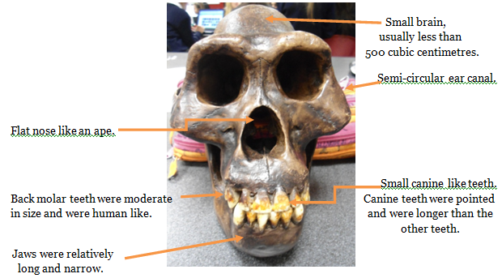
Diastema

Slide 6
Australopithecus africanus
moderate prognathism
slight increase in size of vault
no chin
v. large ascending ramus
brow ridge
parabolic dental arcade
incisors like canines
slight reduction in zygomatic arch and bone size
considerable post orbital constriction
broader molars
anterior foramen magnum
no diastema
Any 5 points for 5 marks:

Slide 7
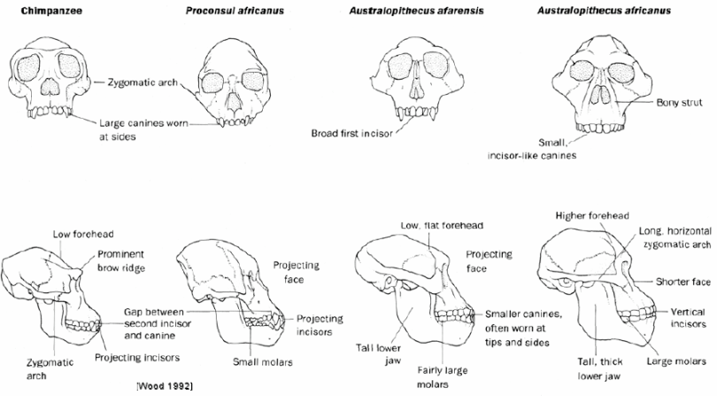
Ascending Ramus

Slide 8
Homo erectus
Reduced prognathism
Occipital bun
Some sagittal crest
Larger cranial capacity
Brow ridge
Reduced post orbital constriction
No diastema
Anterior Foramen magnum
Any 5 points for 5 marks:

Slide 9
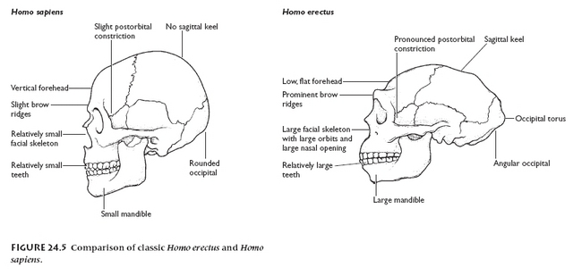

Slide 10
Homo neanderthalensis
Human like but robust
Slight prognathism
Brow ridge
V large vault
Small ascending ranus
Parabolic dental arcade
Heavier reinforcement of skull
No post orbital constriction
Occipital bun
Definite chin
Large cranial capacity
No diastema

Slide 11
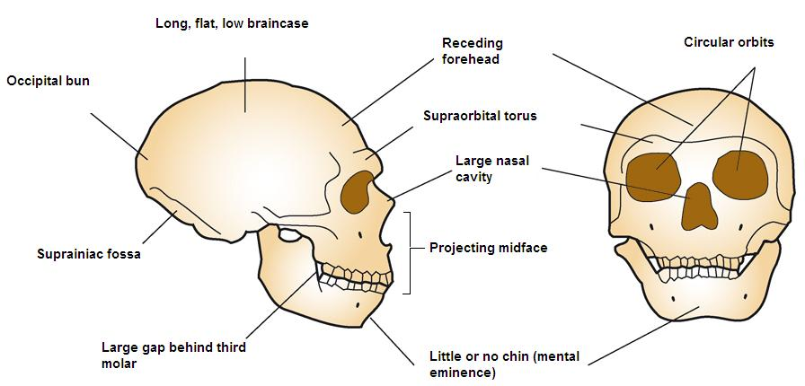

Slide 12
Homo sapiens
Orthognathic face (flat)
No brow ridge
Large rounded vault and increased cranial capacity
Reduced zygomatic arch
Smaller teeth/incisors like canines
Parabolic dental arcade
No diastema
No post orbital constriction
More gracile overall
Definite chin
No occipital bun
Reduced occipital chondyles
Foramen magnum completely at base
Any 5 points for 5 marks:

Slide 13
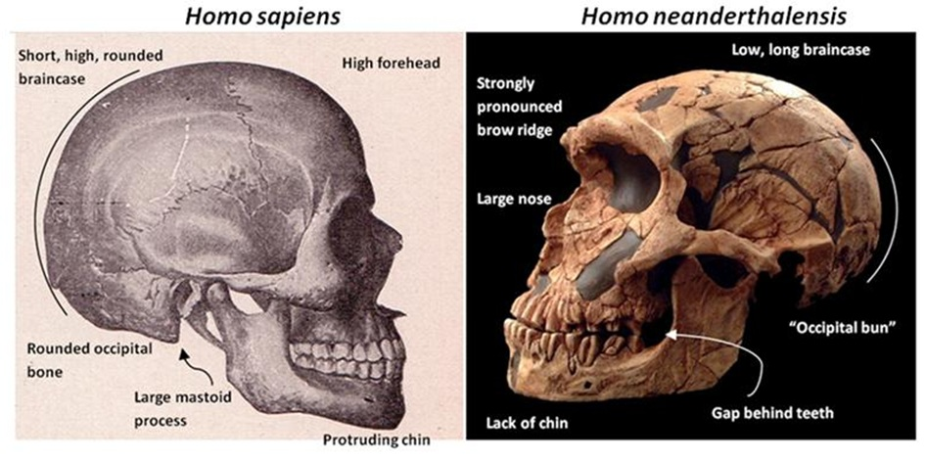

Slide 14
